Slide 1
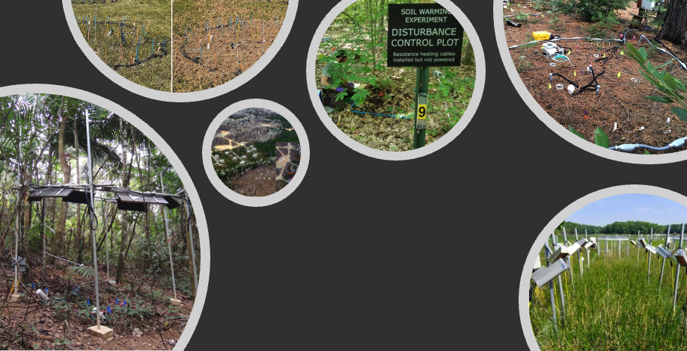
A New Model for Synthesis
The Soil Warming Experiment to Depth Data Integration Effort (SWEDDIE)
Jeffrey Beem-Miller^{1,2}, William Riley², Margaret Torn², Michael Schmidt³, and Peter Reich¹
¹ Institute for Global Change Biology, Univ. of Michigan; ² Climate & Ecosystem Sciences Division, Lawrence Berkeley National Lab.; ³ Dept. of Geography, Univ. of Zurich

Slide 2
When soils warm…
Predicted ∆SOC
inputs
+
500
250
Change in soil C stocks by 2100
(Pg C)
0
-250
-500
+ decomposition
Ensemble of global soil C models
Model mean
Multi-model mean
± sd
(figure adapted from Todd-Brown et al., 2018)
Notes:
Unfortunately, current global soil carbon models do not agree on the relative importance of these two pathways
The figure here is from a synthesis paper by Kathe Todd-Brown and others, and shows predicted changes in global soil carbon stocks by the end of this century [under a high emissions scenario relative concentration pathway of 8.5]
It’s worth noting that all models predict substantial increases in inputs, by a relative factor of 1.4, which is why the mean change is positive
[Multi-model mean of this increase is: 88 ±153 Pg C]
However, there less agreement with regards to the increased decomposition pathway

Slide 3
When soils warm…
Predicted ∆SOC
inputs
+
500
250
Change in soil C stocks by 2100
(Pg C)
0
-250
-500
+ decomposition
Ensemble of global soil C models
Model mean
Multi-model mean
± sd
(figure adapted from Todd-Brown et al., 2018)
…C is gained?
Notes:
Unfortunately, current global soil carbon models do not agree on the relative importance of these two pathways
The figure here is from a synthesis paper by Kathe Todd-Brown and others, and shows predicted changes in global soil carbon stocks by the end of this century [under a high emissions scenario relative concentration pathway of 8.5]
It’s worth noting that all models predict substantial increases in inputs, by a relative factor of 1.4, which is why the mean change is positive
[Multi-model mean of this increase is: 88 ±153 Pg C]
However, there less agreement with regards to the increased decomposition pathway

Slide 4
When soils warm…
Predicted ∆SOC
informed by warming experiments
inputs
+
500
250
Change in soil C stocks by 2100
(Pg C)
0
-250
-500
+ decomposition
Ensemble of global soil C models
Model mean
Multi-model mean
± sd
(figure adapted from Todd-Brown et al., 2018)
…or is C lost?
Notes:
Unfortunately, current global soil carbon models do not agree on the relative importance of these two pathways
The figure here is from a synthesis paper by Kathe Todd-Brown and others, and shows predicted changes in global soil carbon stocks by the end of this century [under a high emissions scenario relative concentration pathway of 8.5]
It’s worth noting that all models predict substantial increases in inputs, by a relative factor of 1.4, which is why the mean change is positive
[Multi-model mean of this increase is: 88 ±153 Pg C]
However, there less agreement with regards to the increased decomposition pathway

Slide 5
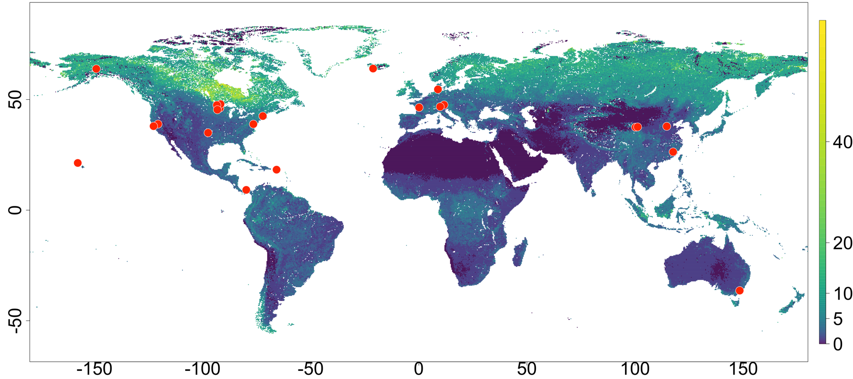
DeepSoil 2100 Warming Experiments
CPHR
FRHT
MRIT
B4WM
SPRC
ACHN
ACBB
STLB
185E
PTRY
TRCN
HVFR
SWMP
BLDG
SMTX
TEAM
KAEFS
SNMG
TRCE
SOC stock
0-10 cm
(kg m²)
LYON
SWTR
FTCL

Slide 6
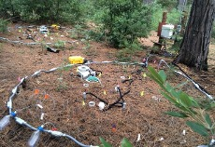
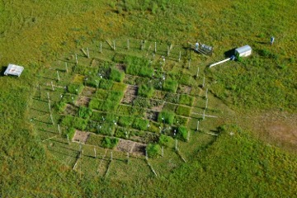
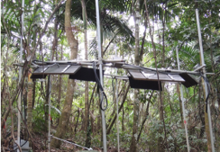
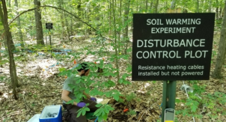
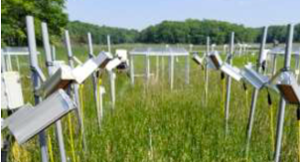
Soil
Warming
Experiment
to Depth
Data
`
`
`
`
`
`
Integration
Effort
Notes:
All of the sites in the network were set up independently, and designed to answer specific questions
Largely united in the emphasis on constructing a carbon budget, but with different instrumentation, methodologies, and specific science questions
Can we gain a more nuanced, comprehensive understanding of which processes are affected in which settings? The first step is to create a synthesized database…

Slide 7
Raw data harmonized in database…
Soil
Warming
Experiment
to Depth
Data
`
`
`
`
`
`
Integration
Effort
Notes:
All of the sites in the network were set up independently, and designed to answer specific questions
Largely united in the emphasis on constructing a carbon budget, but with different instrumentation, methodologies, and specific science questions
Can we gain a more nuanced, comprehensive understanding of which processes are affected in which settings? The first step is to create a synthesized database…

Slide 8
…creating positive feedback—methods & knowledge sharing, coordinated sampling…
Soil
Warming
Experiment
to Depth
Data
`
`
`
`
`
`
Integration
Effort
Notes:
All of the sites in the network were set up independently, and designed to answer specific questions
Largely united in the emphasis on constructing a carbon budget, but with different instrumentation, methodologies, and specific science questions
Can we gain a more nuanced, comprehensive understanding of which processes are affected in which settings? The first step is to create a synthesized database…

Slide 9
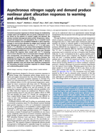
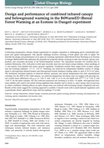
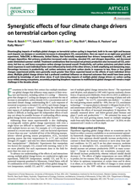
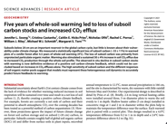
…yielding publications throughout the cycle
`
`
`
`
`
`
Notes:
All of the sites in the network were set up independently, and designed to answer specific questions
Largely united in the emphasis on constructing a carbon budget, but with different instrumentation, methodologies, and specific science questions
Can we gain a more nuanced, comprehensive understanding of which processes are affected in which settings? The first step is to create a synthesized database…

Slide 10


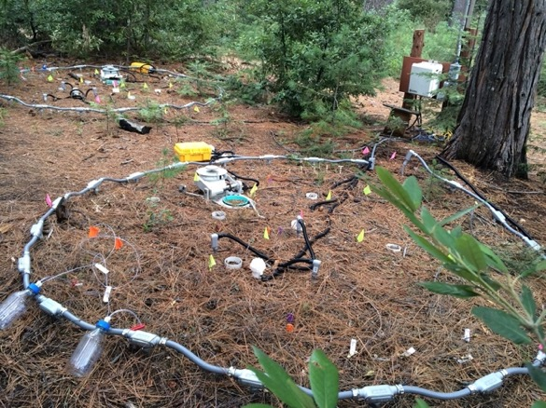



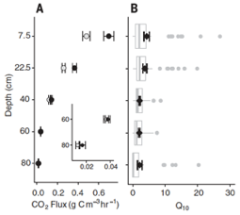
DATA PIPELINE
database
raw data
data
harmonization
.csv
analysis
dictionary
output
Photo credit: C. Hicks Pries
‘output’ fig. from Hicks Pries et al. 2017
.csv
Notes:
Query-driven
Minimize manual translations of data, which are error prone
Have searchable annotation files
Flexible & efficient

Slide 11

DATA MODEL
core files
data files
soilT
soilH₂O
air T
CO₂ flux
experiment
site
data dictionary files
soilT
soilH₂O
air T
CO₂ flux
Blodgett Forest
plot
file level metadata
blodgett_flmd
Notes:
Query-driven
Minimize manual translations of data, which are error prone
Have searchable annotation files
Flexible & efficient

Slide 12
DATA MODEL
core files
Experiment
Warming infrastructure
Initial on/final off dates
Additional treatments
site
plot
Notes:
Query-driven
Minimize manual translations of data, which are error prone
Have searchable annotation files
Flexible & efficient

Slide 13
DATA MODEL
core files
Site
Climate, soils, vegetation
Coordinates
experiment
plot
Notes:
Query-driven
Minimize manual translations of data, which are error prone
Have searchable annotation files
Flexible & efficient

Slide 14
DATA MODEL
core files
experiment
Plot
Experimental design
Plot IDs & treatments
site
Notes:
Query-driven
Minimize manual translations of data, which are error prone
Have searchable annotation files
Flexible & efficient

Slide 15
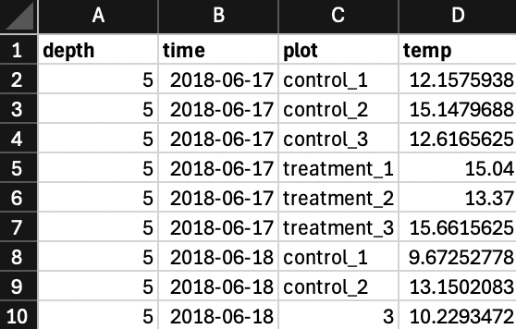
DATA MODEL
data file
soilT
Notes:
Query-driven
Minimize manual translations of data, which are error prone
Have searchable annotation files
Flexible & efficient

Slide 16
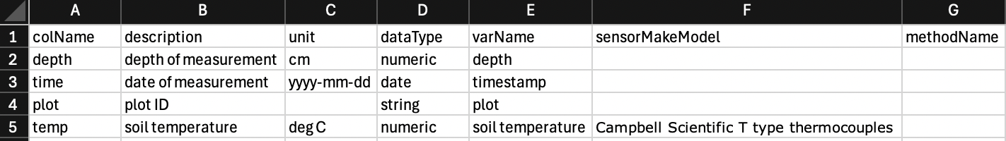
DATA MODEL
data file
soilT
soilT
data dictionary file
Notes:
Query-driven
Minimize manual translations of data, which are error prone
Have searchable annotation files
Flexible & efficient

Slide 17
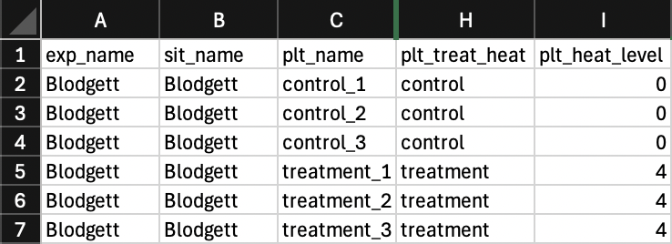
DATA MODEL
plot file
*links treatments & data*
data file
soilT
plot
soilT
data dictionary file
Notes:
Query-driven
Minimize manual translations of data, which are error prone
Have searchable annotation files
Flexible & efficient

Slide 18
How does warming change…
First Synthesis Results!

Slide 19
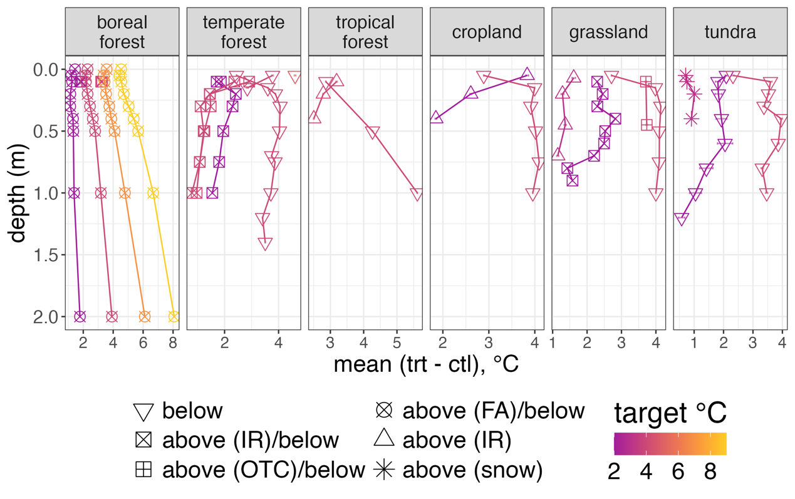
How does warming change…
…soil T with depth?
Notes:
Heating targets not always met at depth or the surface
Sites with below ground heating only tend to achieve heating closest to the target in deeper soil layers, i.e., the surface soils are below the target,
while sites with above ground heating show the opposite (and expected) trend of lower than target temperatures in the deeper layers, but achieve target heating near the surface

Slide 20
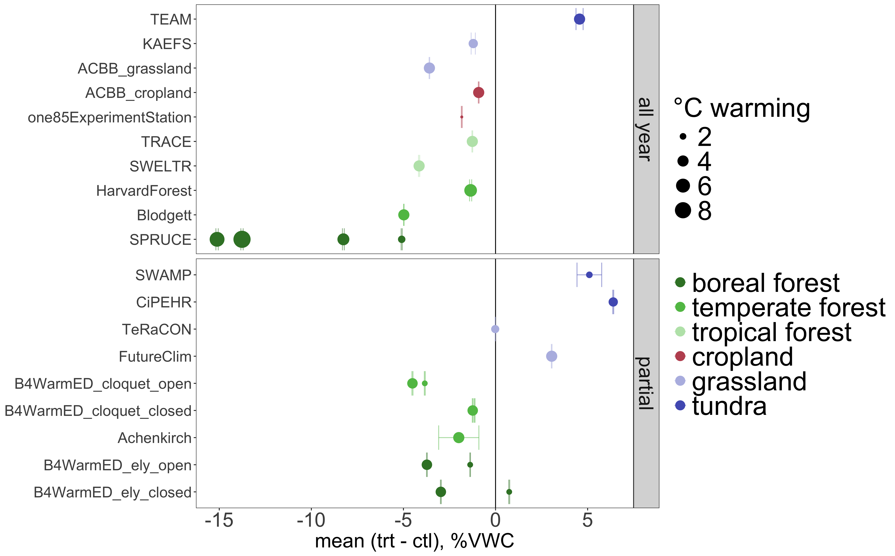
How does warming change…
…soil moisture overall?
Notes:
More drying observed in forests than in grasslands; tundra wetter with warming (permafrost melt)
Soil moisture differences tend to increase with increasing warming

Slide 21
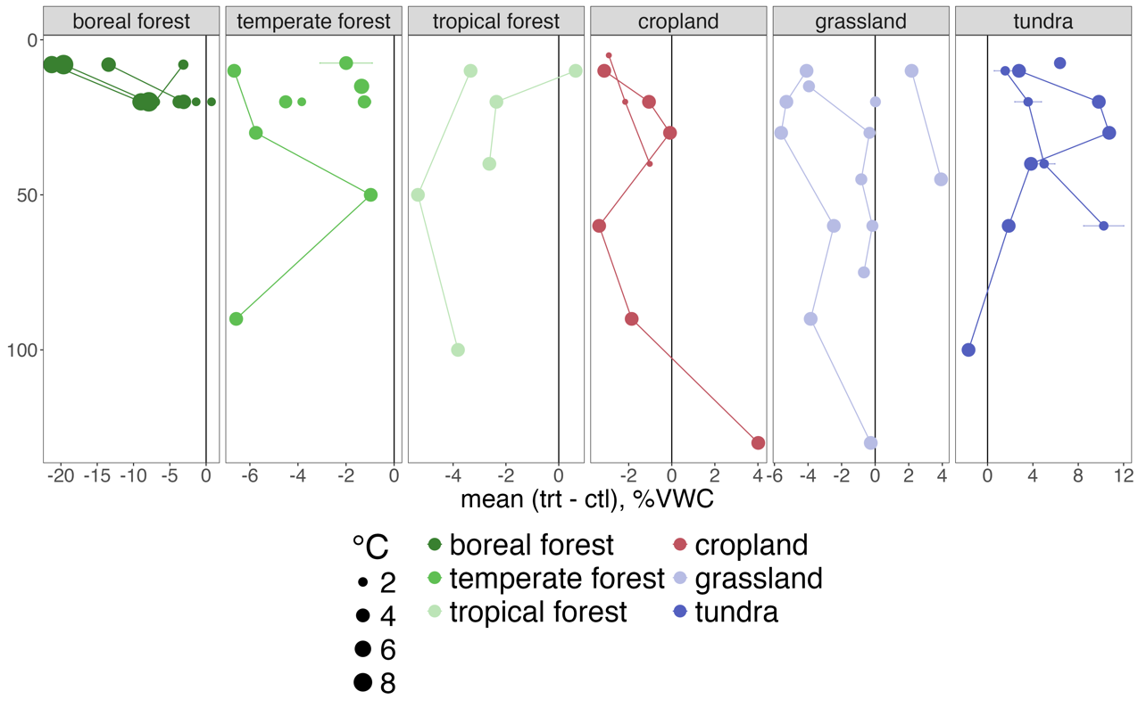
How does warming change…
…soil moisture with depth?

Slide 22
How does warming change…
Sneak peak at next steps…

Slide 23
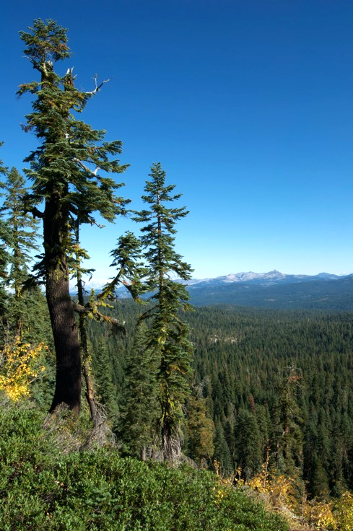
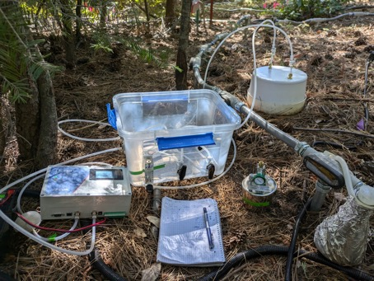
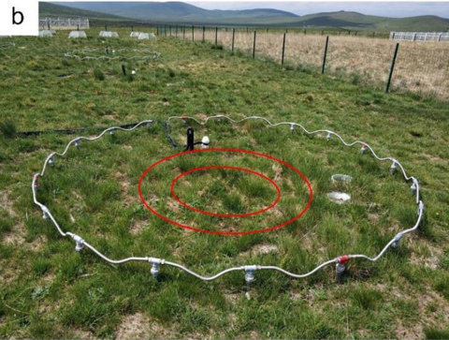
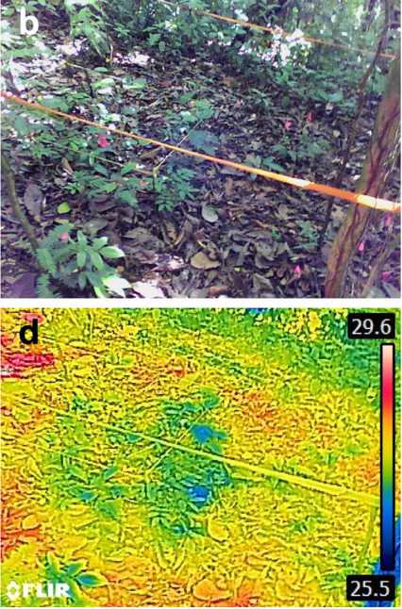
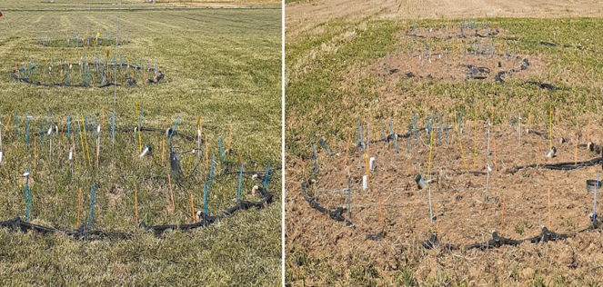
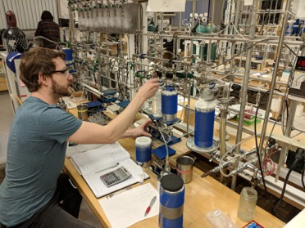
Blodgett
temperate forest
TEAM
alpine grassland
Is excess CO₂ from newly fixed or formerly stable SOC?
SWELTR
tropical forest
ACBB
temperate grassland/ cropland
Notes:
SWELTR from Nottingham et al., 2020 https://doi.org/10.1038/s41586-020-2566-4
ACBB ?
TEAM from Chen et al., 2024 https://doi.org/10.1038/s41467-024-48736-w

Slide 24
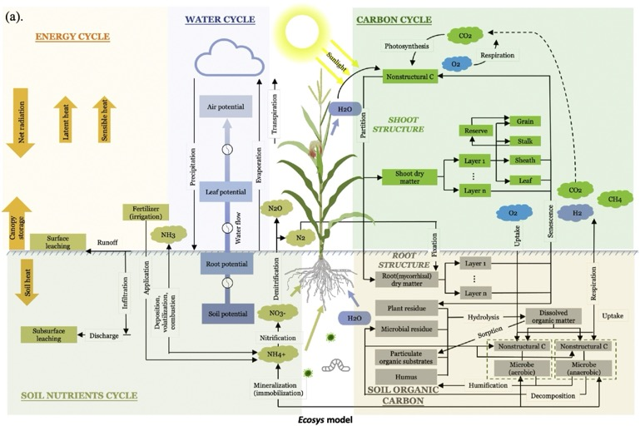
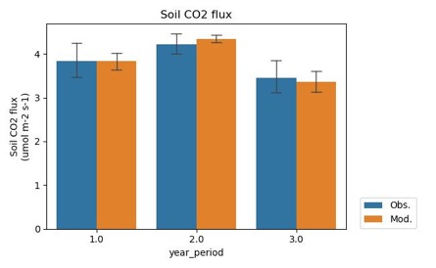
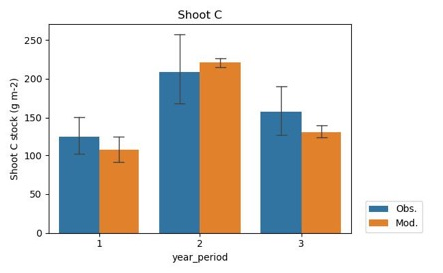
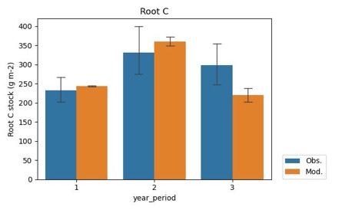
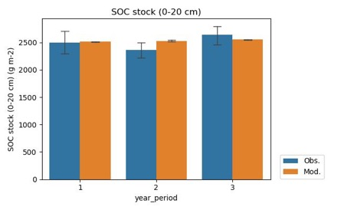
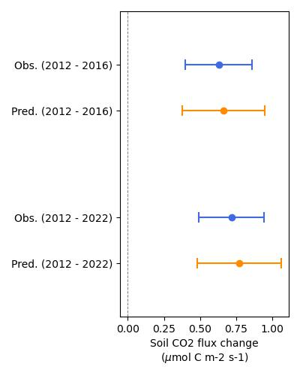
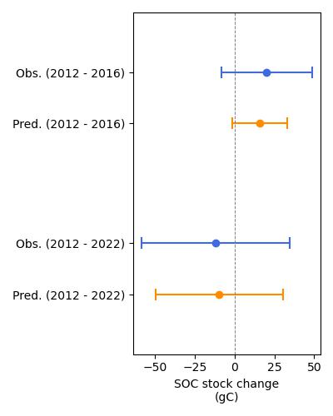
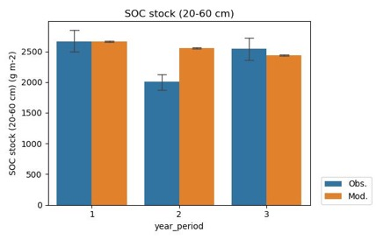
Using a process-rich model (ecosys) at TeRaCON
Capture the yearly changes
Capture the differences between ambient and warming plots
A sub-hourly time-step mechanistic model fully coupled plant-microbe-soil carbon and nutrient cycling
Lei Zhang, William Riley, Peter Reich, Jinyun Tang, Margaret Torn, et al. (In prep).

Slide 25
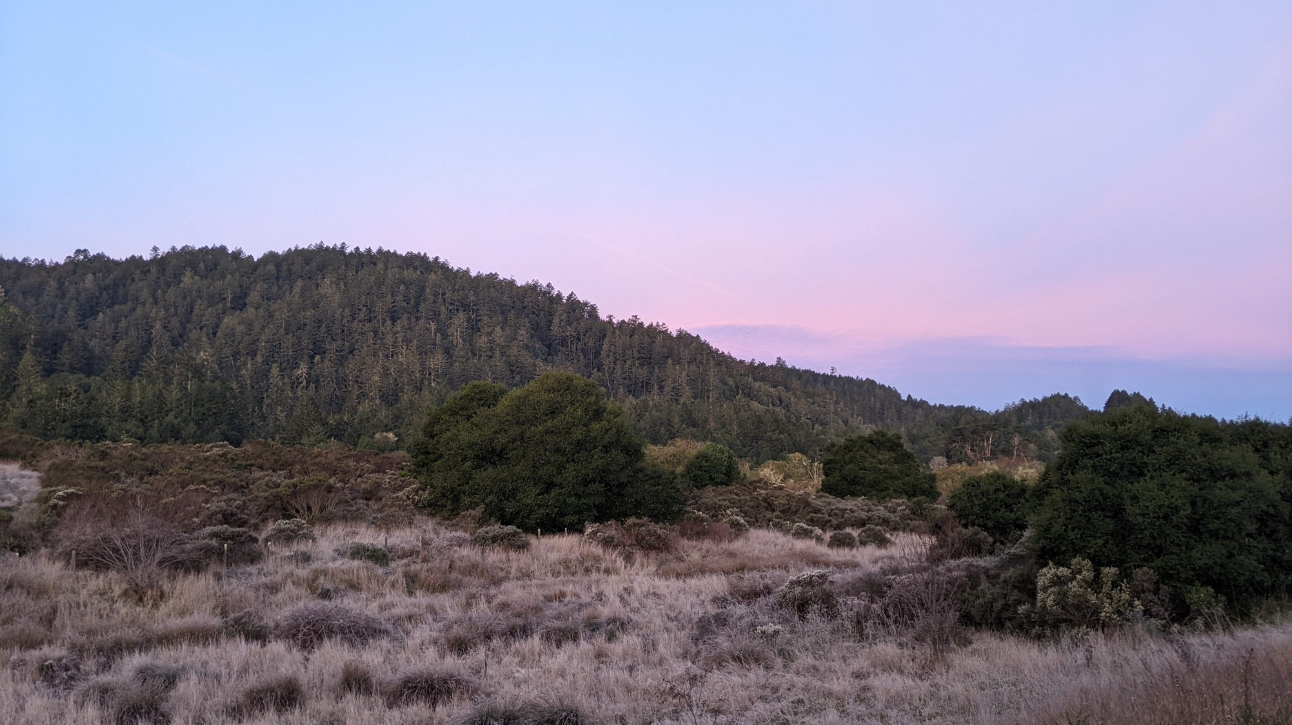
Thanks!
https://iscn.fluxdata.org/network/partner-networks/deepsoil2100/
Grassland Warming Experiment Site
Point Reyes, USA

Slide 26
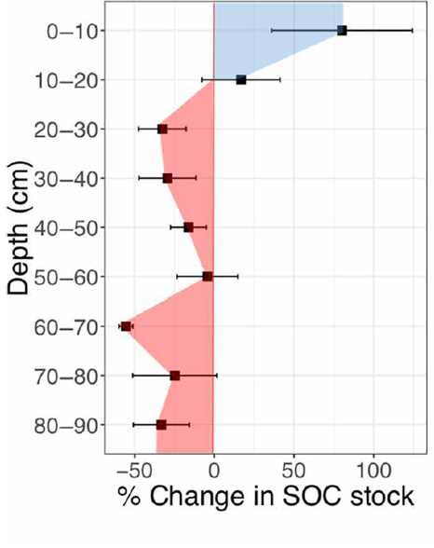
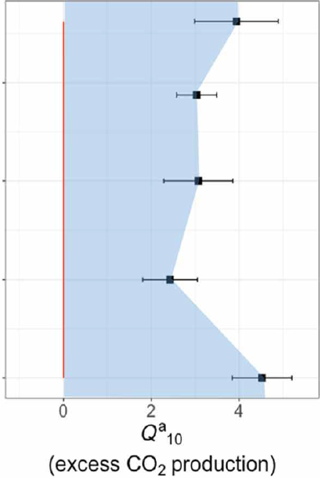
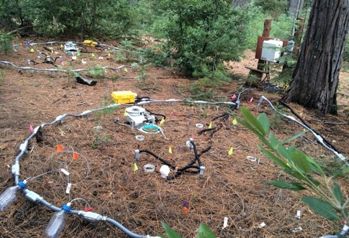
Warming increases ecosystem respiration…
Blodgett Forest
+ 4 °C
Soong et al., 2021. Five years of whole-soil warming led to loss of subsoil carbon stocks and increased CO2 efflux. Saci. Adv.

Slide 27
Warming increases ecosystem respiration…
…and decreases SOC stocks
Blodgett Forest
+ 4 °C
Soong et al., 2021. Five years of whole-soil warming led to loss of subsoil carbon stocks and increased CO2 efflux. Saci. Adv.

Slide 28
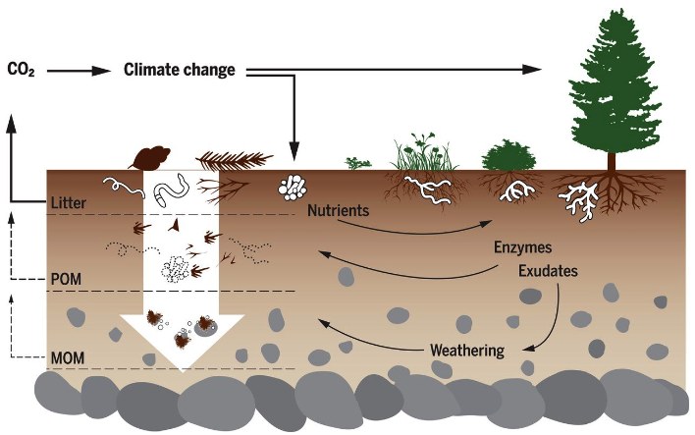
How does warming affect ecosystem C cycling?
(Fig. from Hagedorn et al., 2019, DOI:10.1126/science.aax4737)

Slide 29
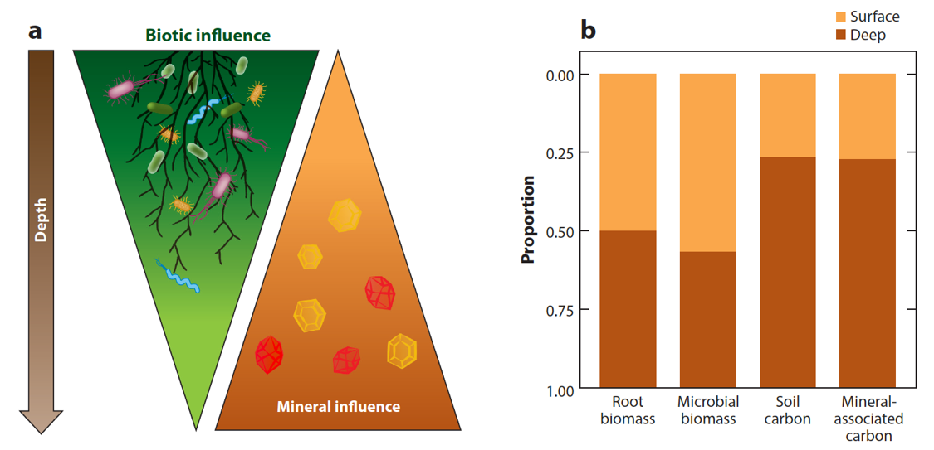
How does warming affect ecosystem C cycling?
…with depth?
(figure from Hicks Pries et al., 2023)
Hicks Pries et al., 2023. The Deep Soil Organic Carbon Response to Global Change. Annu. Rev. Ecol. Evol. Syst. 2023. 54:375–401

